Slide 1
CMSC204
Kartchner
V(StateGraph) = {Oregon, Alaska, Texas, Hawaii, Vermont, NewYork, California}
E(StateGraph) = {(Alaska, Oregon), (Hawaii, Alaska), (Hawaii, Texas), (Texas, Hawaii), (Hawaii, California), (Hawaii, New York), (Texas, Vermont), (Vermont, California), (Vermont, Alaska)}
1. Draw the StateGraph
Alaska
Texas
Oregon
Hawaii
Vermont
NewYork
California

Slide 2
a. Show the adjacency matrix that would describe the edges in the graph. Store the vertices in alphabetical order
States
0 1 2 3 4 5 6
0. Alaska
1. California
2. Hawaii
3. New York
4. Oregon
5. Texas
6. Vermont
0
1
2
3
4
5
6
0 | 0 | 0 | 0 | 1 | 0 | 0
0 | 0 | 0 | 0 | 0 | 0 | 0
1 | 1 | 0 | 1 | 0 | 1 | 0
0 | 0 | 0 | 0 | 0 | 0 | 0
0 | 0 | 0 | 0 | 0 | 0 | 0
0 | 0 | 1 | 0 | 0 | 0 | 1
1 | 1 | 0 | 0 | 0 | 0 | 0
3. b. Show the adjacency lists
that would describe the edges in the graph
Alaska: Oregon
California:
Hawaii: Alaska, California, New York, Texas
New York:
Oregon:
Texas: Hawaii, Vermont
Vermont: Alaska, California

Slide 3
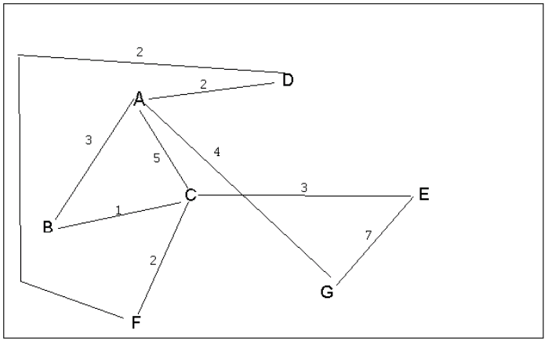
4 a. Which of the following lists the graph nodes in depth first order beginning with E?
A) E, G, F, C, D, B, A
B) G, A, E, C, B, F, D
C) E, G, A, D, F, C, B
D) E, C, F, B, A, D, G
4 b. Which of the following lists the graph nodes in breadth first order beginning at F?
A) F, C, D, A, B, E, G
B) F, D, C, A, B, C, G
C) F, C, D, B, G, A, E
D) a, b, and c are all breadth first traversals

Slide 4
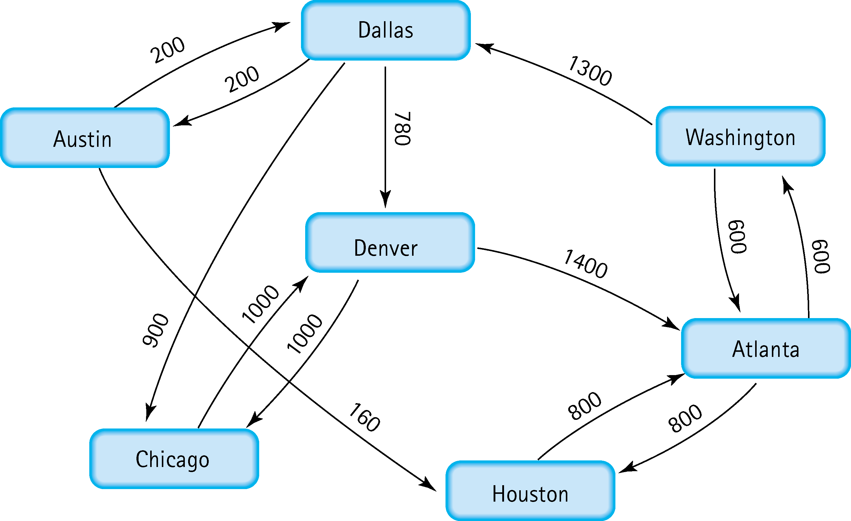
Find the shortest distance from Atlanta to every other city
Atlanta: 0
Washington: 600
Houstin: 800
Denver: 2680
Dallas: 1900
Chicago: 2800
Austin: 2100

Slide 5
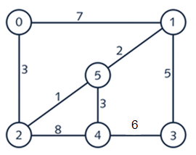
6. Find the minimal spanning tree using Prim’s algorithm. Use
0 as the source vertex . Show the steps.
(0, 2): 3
(2, 5): 1
(5, 1): 2
(1, 3): 5
(3, 4): 6
{0, 2, 5, 1, 3)

Slide 6
7. Find the minimal spanning tree using Kruskal’s algorithm.
Show the weights in order and the steps.
(2, 5): 1
(5, 1): 2
(5, 4): 3
(0, 2): 3
(1, 3): 5
(3, 4): 6
(0, 1): 7
(2, 4): 8

Slide 7
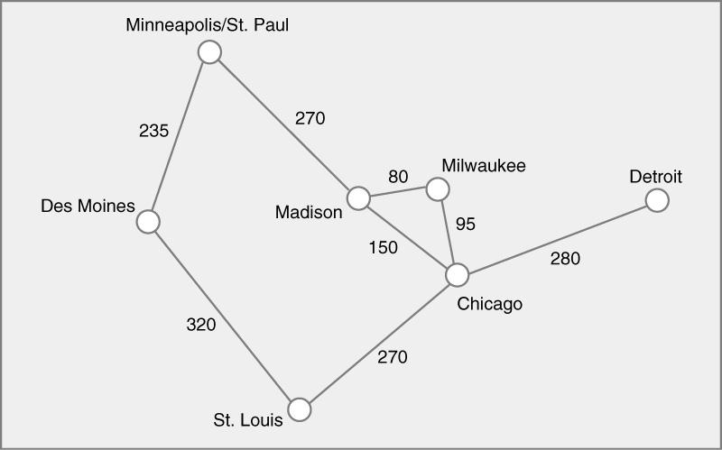
8. Find the minimal spanning tree using the algorithm you prefer. Use
Minneapolis/St. Paul as the source vertex
(Minneapolis, Des Moines): 235 (Chicago, St Louis): 270
(Minneapolis, Madison): 270 (Chicago, Detroit): 280
(Madison, Milwaukee): 80
(Milwaukee, Chicago): 95

Slide 8
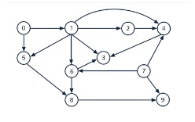
9. List the nodes of the graph in a breadth first topological ordering. Show the
steps using arrays predCount, topologicalOrder and a queue
predCount: (0, 1, 1, 1, 4, 2, 3, 0, 2, 3)
Queue: (0, 7, 1, 2, 3, 5, 4, 6, 8, 9)
topologicalOrder: (0, 7, 1, 2, 3, 5, 4, 6, 8, 9)

Slide 9

10. List the nodes of the graph in a breadth first topological ordering.
(Start, Discrete Math, Programming 1, Programming 2, Computer Organization, Algorithms, High-Level Languages, Operating Systems, Theory of Computation, Compilers, Senior Seminar, End)

